Slide 1
Literary Devices
ENG 1DI – Mr. Bignell

Slide 2
Mood
The feeling a reader receives when reading a text
ie. Happy, Depressed, Curious, etc.

Slide 3
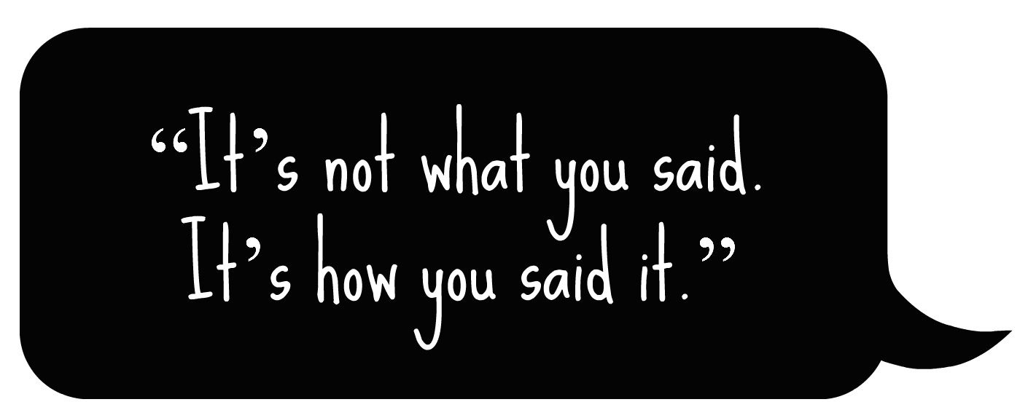
Tone
How an author or character says things
ie. Sarcastic, Childish, Formal, etc.

Slide 4
Atmosphere
The energy of a situation in a literary work created through word choice
“We’re having a pop quiz!” = horrified; “Throw out your books!” = excited.

Slide 5
Setting
The time, location and atmosphere where the story takes place

Slide 6
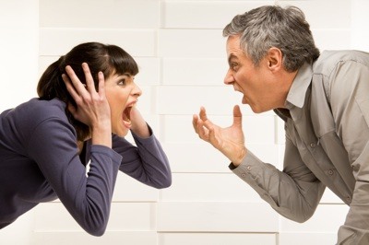
Conflict
A problem that acts as a driving force to the plot.
Man vs. Man: A struggle between people.
Man vs. Nature: A struggle between a person and their natural environment.
Man vs. the Supernatural: A struggle between a person and a supernatural force.
Man vs. Self: A struggle between someone and their inner emotions or desires.

Slide 7
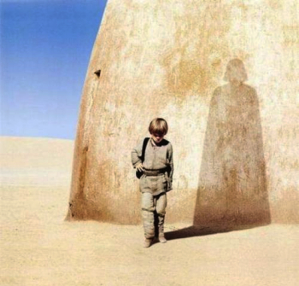
Forshadowing
When the author hints that something is going to happen.

Slide 8
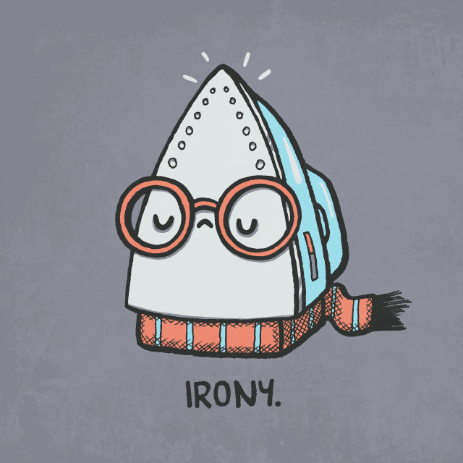
Irony
A discrepancy between what is expected and what happens.

Slide 9
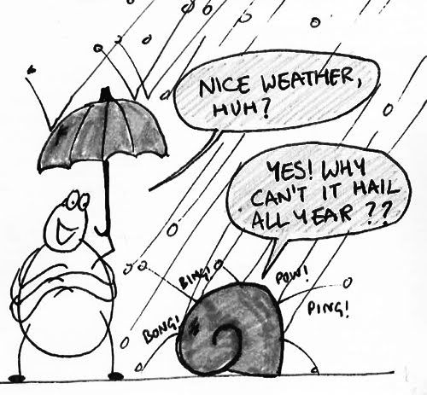
Verbal Irony
When there are multiple meanings to someone’s words.

Slide 10
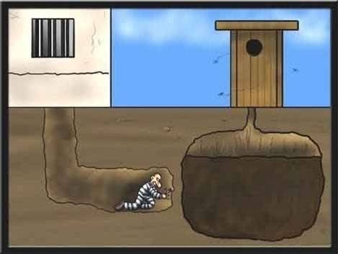
Dramatic Irony
When the audience knows something that a character does not.

Slide 11
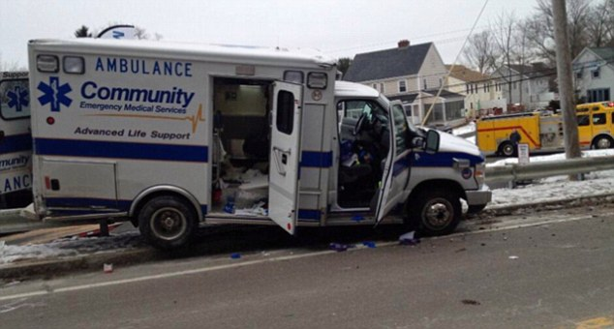
Situational Irony
When a character finds themselves in an unexpected situation.

Slide 12
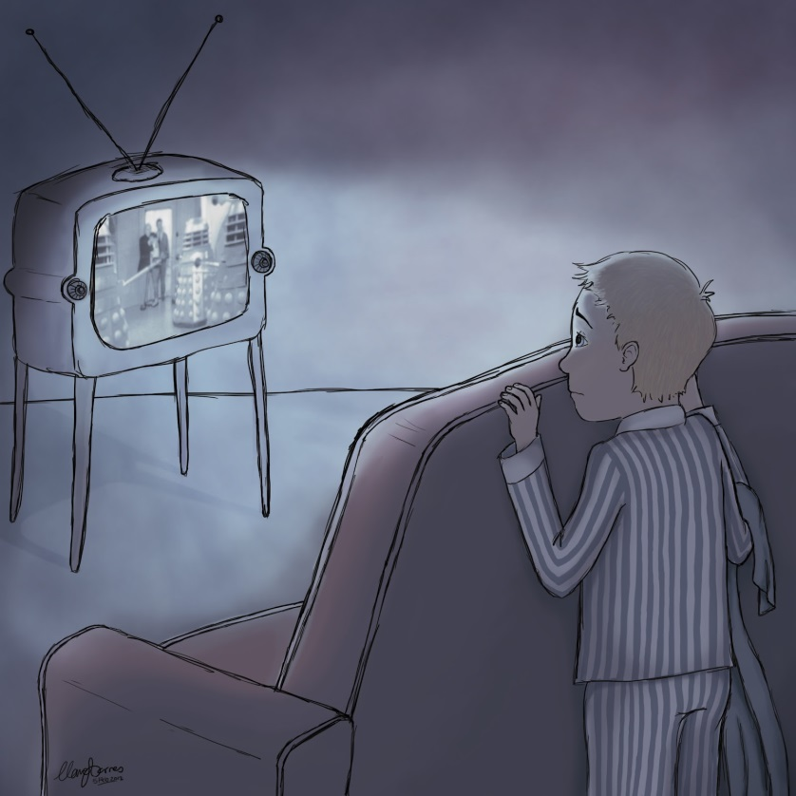
Suspense
Excitement that the reader feels while anticipating what’s to come in the story.

Slide 13
Symbol
A tangible item that represents something greater.

Slide 14
Topic
A central idea of a story.
It’s one to two words

Slide 15
Theme
The author’s opinion on the topic (which is arguable).
A theme is not a moral.

Slide 16
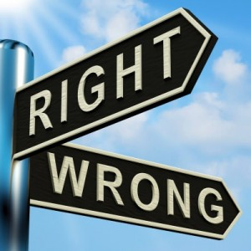
Moral
A lesson learned from a story.

Slide 17
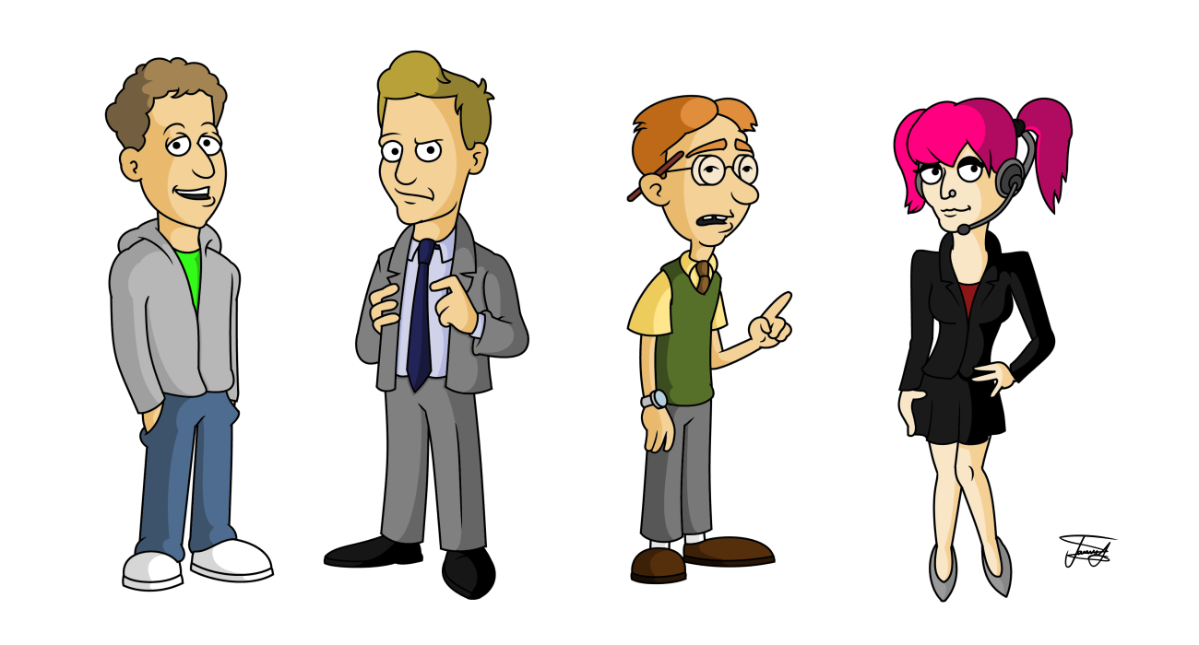
Character
A person in a text

Slide 18
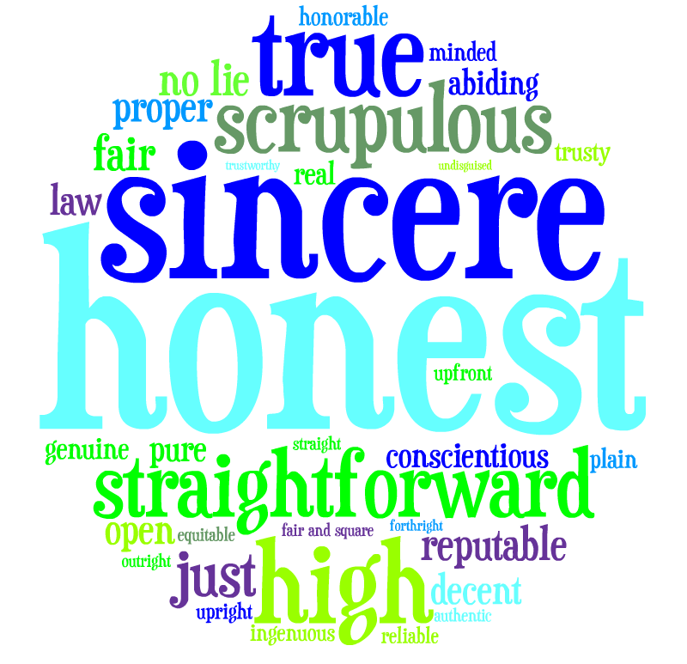
Character Traits
A character’s description which can be created directly or indirectly by what they say, do, act, feel, think, etc..

Slide 19
Protagonist
The most important character in the text
not necessarily the narrator, or a “good” guy

Slide 20
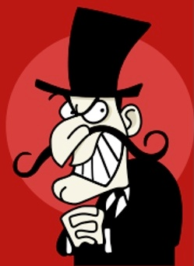
Antagonist
The protagonist’s competitor

Slide 21
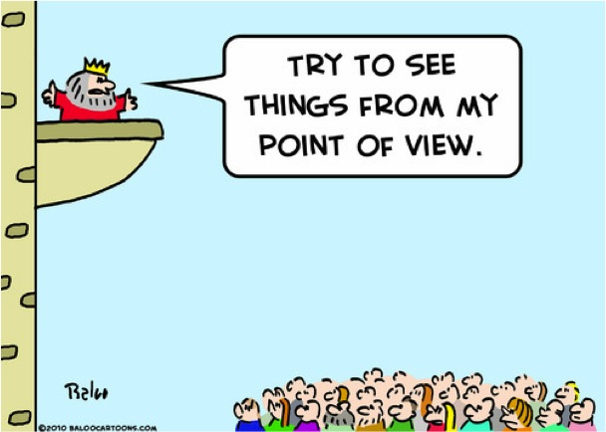
Point of View
The perspective from which the story is told.

Slide 22
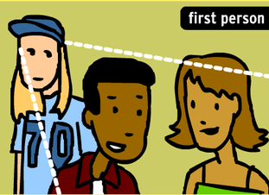
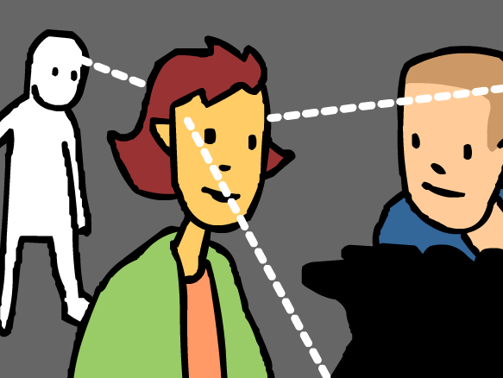
Point of View
First Person
Third Person
When a story is told through a character’s perspective.
Hint: They will use the word “I” to convey their thoughts.
When a story is told from an unidentified third party’s perspective that is not associated with any particular character.

Slide 23
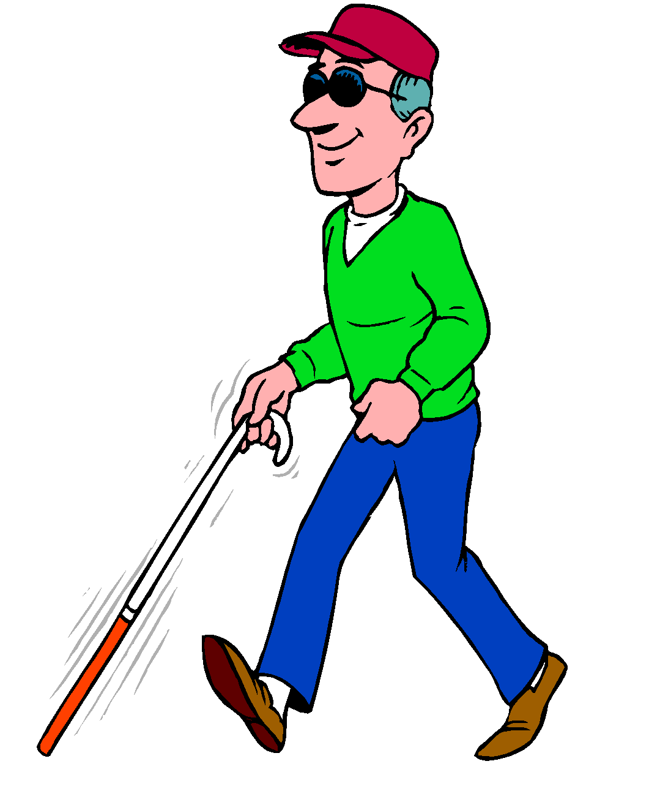
Point of View
Limited
Omniscient
A narrator that restricts itself from telling the story from one (or multiple) perspective(s).
An all knowing narrator that can tell the thoughts of any character

Slide 24
Point of View
The point of view will be:
First Person
Limited
AND
OR
OR
Third Person
Omniscient

