Slide 1
Plot Structure

Slide 2
What Is PLOT?
Plot is the order of events in a story or any other type or narrative

Slide 3
Draw & Remember This Line
4
5
3
6
1
2

Slide 4
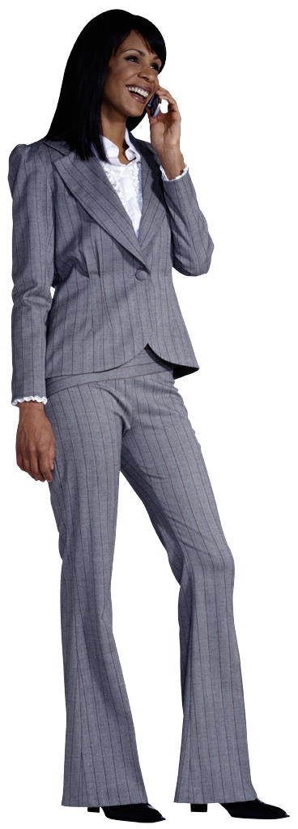
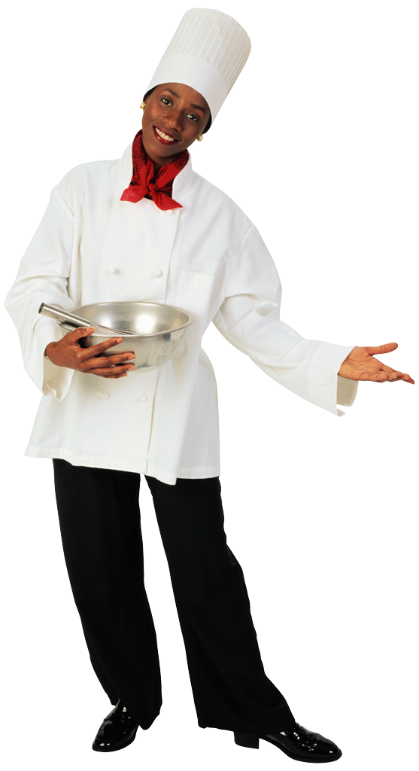
Introduction or Exposition
Beginning of the plot where the reader discovers the story’s SETTING and CHARACTERS
CHARACTERS
Exposition

Slide 5
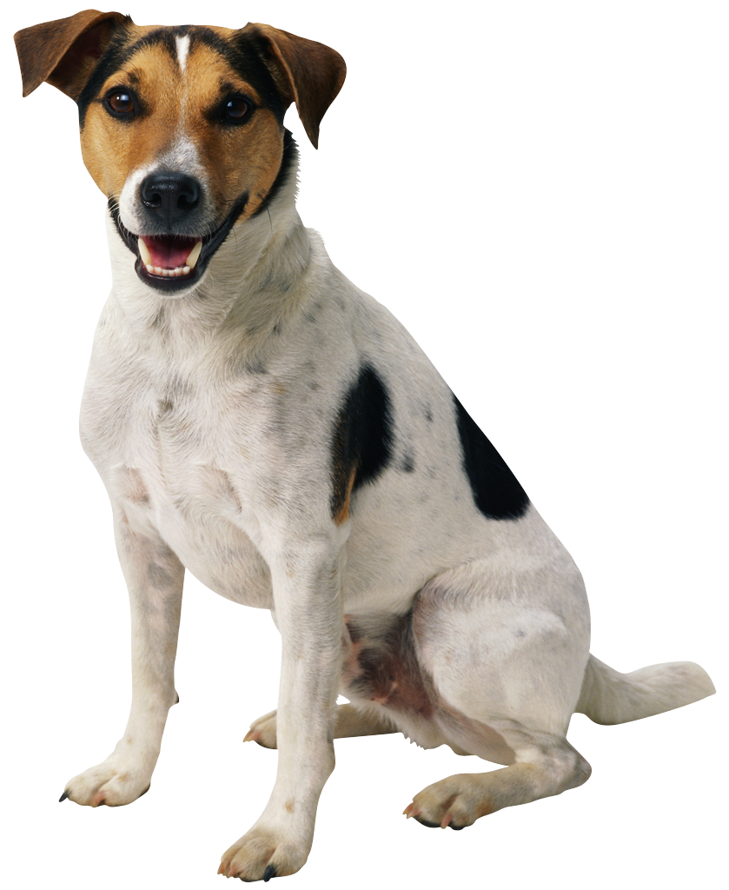
Introduction or Exposition
Beginning of the plot where the reader discovers the story’s SETTING and CHARACTERS
CHARACTERS
Exposition

Slide 6
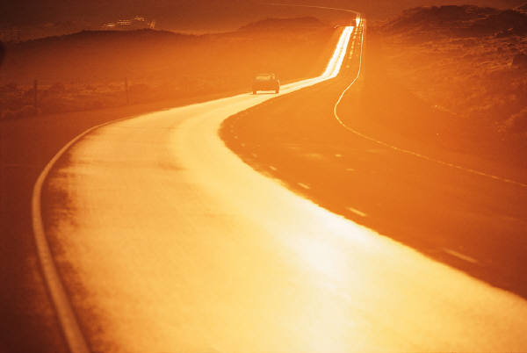
Introduction or Exposition
Beginning of the plot where the reader discovers the story’s SETTING and CHARACTERS
CHARACTERS
and
SETTING
Exposition

Slide 7
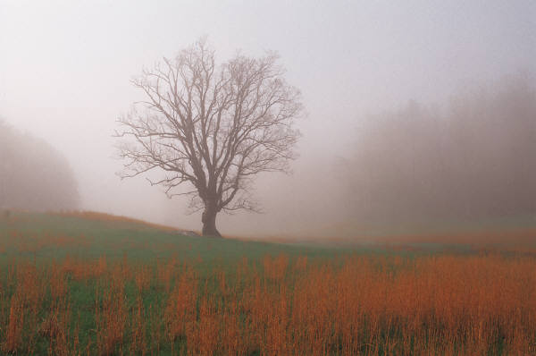
Introduction or Exposition
Beginning of the plot where the reader discovers the story’s SETTING and CHARACTERS
CHARACTERS
and
SETTING
Exposition

Slide 8
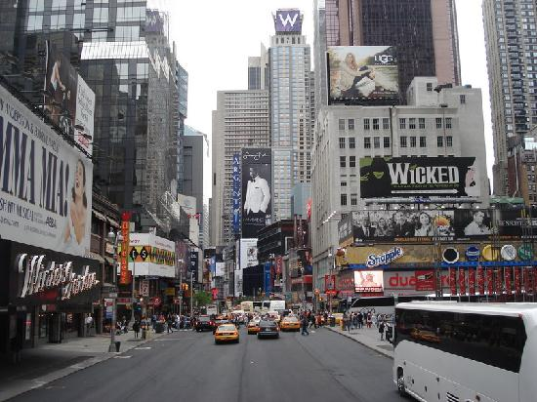
Introduction or Exposition
Beginning of the plot where the reader discovers the story’s SETTING and CHARACTERS
CHARACTERS
and
SETTING
Exposition

Slide 9
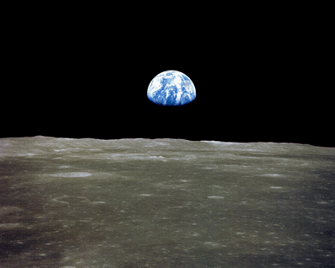
Introduction or Exposition
Beginning of the plot where the reader discovers the story’s SETTING and CHARACTERS
CHARACTERS
and
SETTING
Exposition

Slide 10
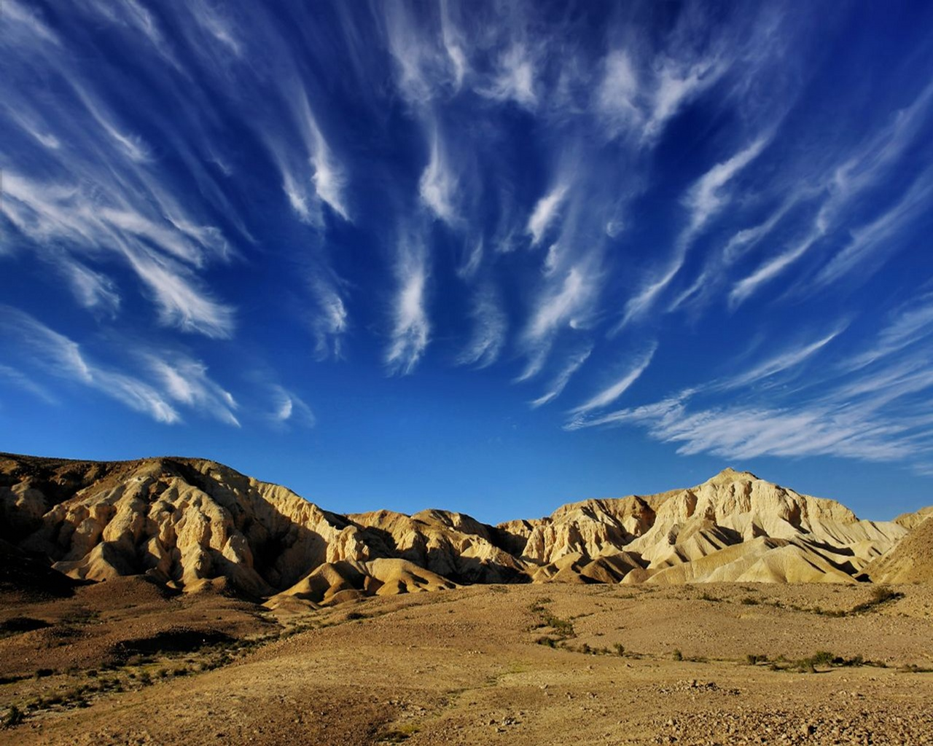
Introduction or Exposition
Beginning of the plot where the reader discovers the story’s SETTING and CHARACTERS
CHARACTERS
and
SETTING
Exposition

Slide 11
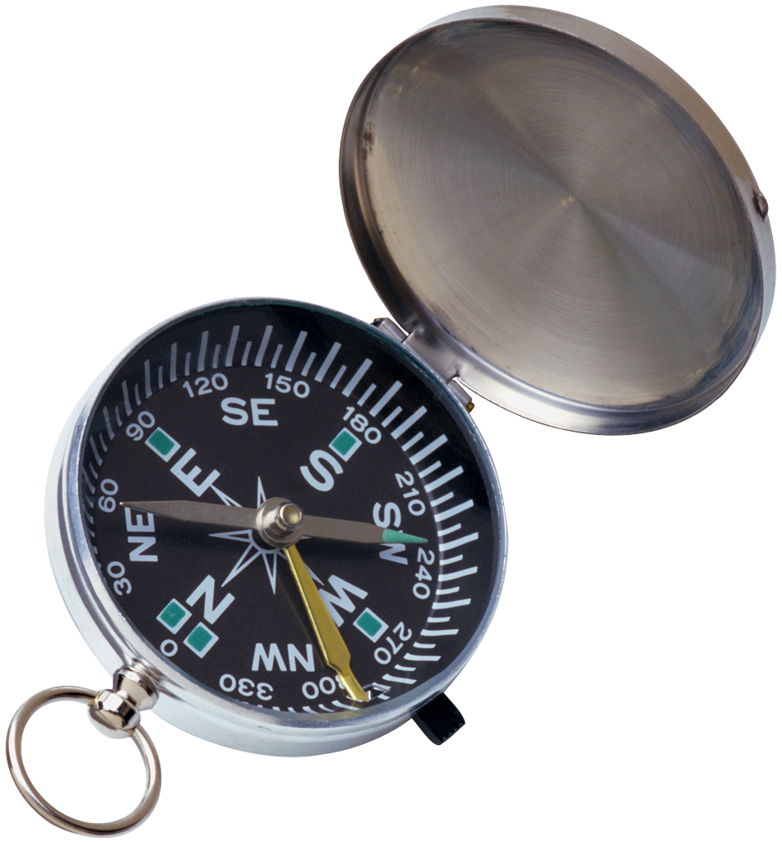
TRIGGER INCIDENT
The point the PLOT where the
character or characters face a PROBLEM
Exposition
TRIGGER INCIDENT

Slide 12
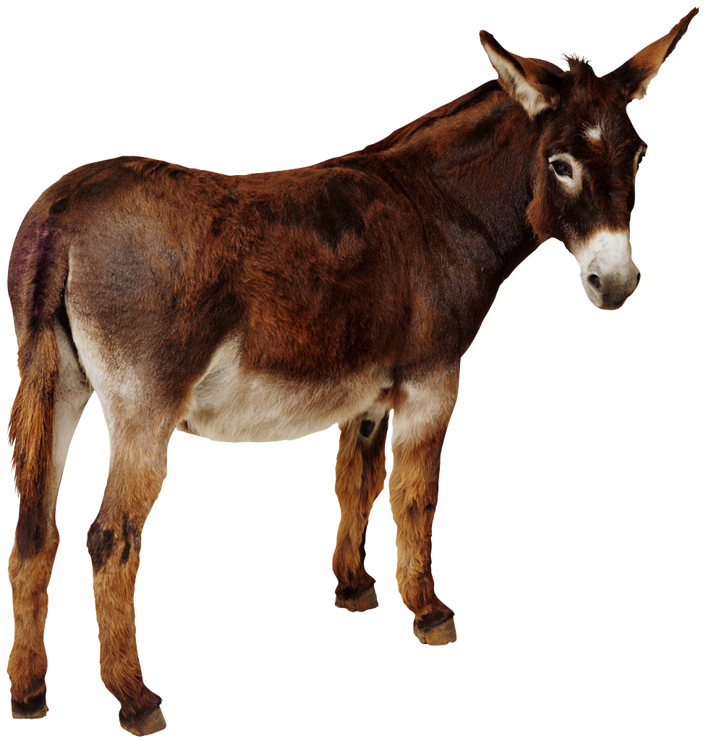
Rising Action
The central part of a story during which various problems arise, leading up to the climax.
Rising Action
Exposition
TRIGGER INCIDENT

Slide 13
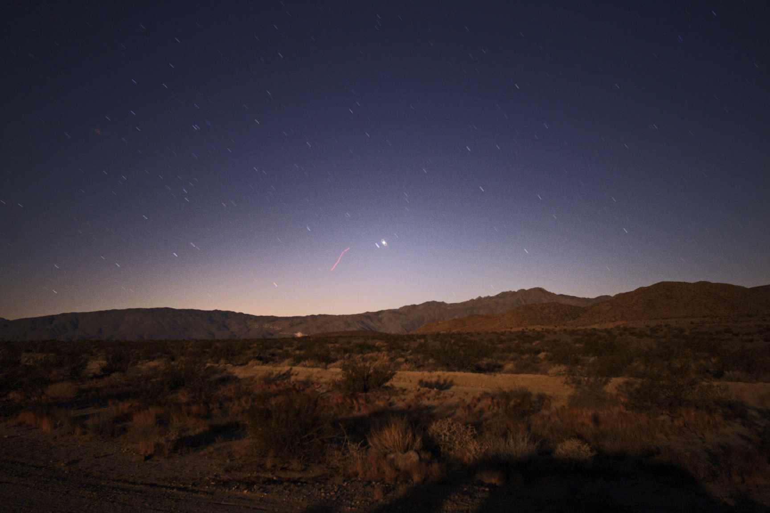
Rising Action
The central part of a story during which various problems arise, leading up to the climax.
Rising Action
Exposition
TRIGGER INCIDENT

Slide 14
Climax
The high point of the story, where a culmination of events create the peak of the CONFLICT and SUSPENSE.
Climax
Rising Action
Exposition
TRIGGER INCIDENT

Slide 15
Falling Action
This part of the story shows the result of the climax, and its effects on the characters, setting and proceeding events
Climax
Falling Action
Rising Action
Exposition
TRIGGER INCIDENT

Slide 16
Resolution or Dénouement
This part of the story consists of a series of events that follow the climax, and serves as the conclusion of the story
Climax
Falling Action
Rising Action
Resolution or
Dénouement
(“to untie”)
Exposition
TRIGGER INCIDENT

Slide 17
Dénouement
This part of the story consists of a series of events that follow the climax, and serves as the conclusion of the story
Climax
Resolution or
Dénouement
(“to untie”)
Falling Action
Rising Action
Exposition
TRIGGER INCIDENT

Slide 18
Remember This Line
4 Climax
5 Falling Action
3 Rising
Action
6 Resolution
1 Introduction
2 Trigger Incident

Slide 19
THE END!

