Slide 1
Introduction to Fairytales
ENG 2PI – Mr. Bignell

Slide 2
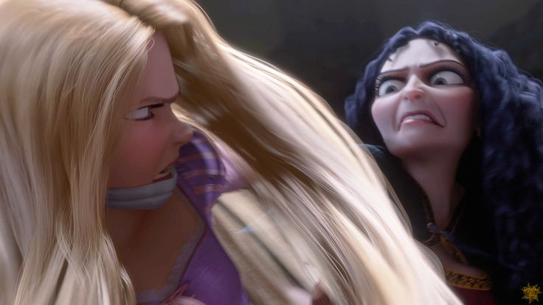
What is a Fairy Tale?
Simple form of a Short Story involving far fetched events
Conflict typically involves a fight between good and evil
Teaches the reader a moral lesson
Characters are extreme examples of good and evil

Slide 3
Discuss:
What is your favourite fairy tale?

Slide 4
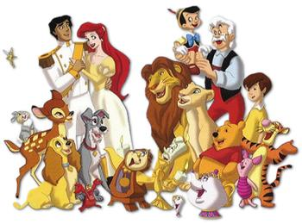
Traits of good characters
Gentleness
Innocence
Beauty
Selflessness
Patience
Honesty

Slide 5
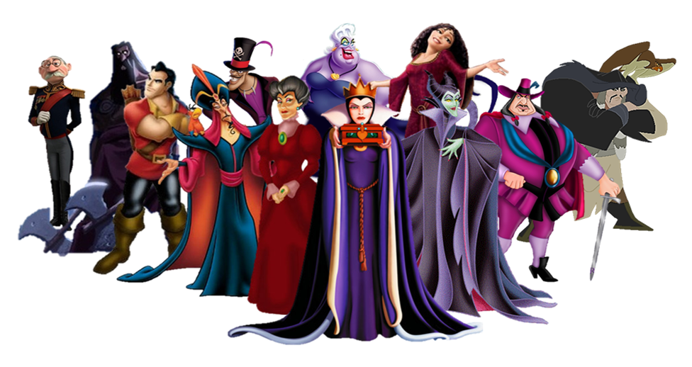
Traits of evil characters
Ugliness
Greed
Cruelty
Dishonesty
Arrogance
Selfishness

Slide 6
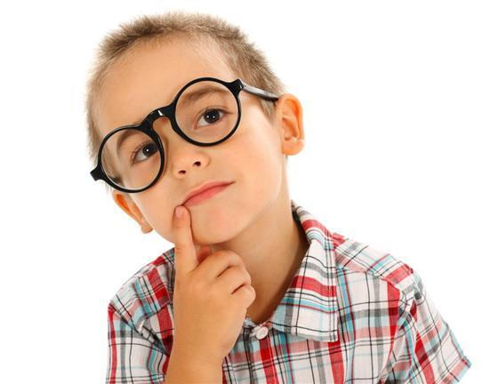
Think about it…
How do fairytales condition kids to think a certain way?

Slide 7
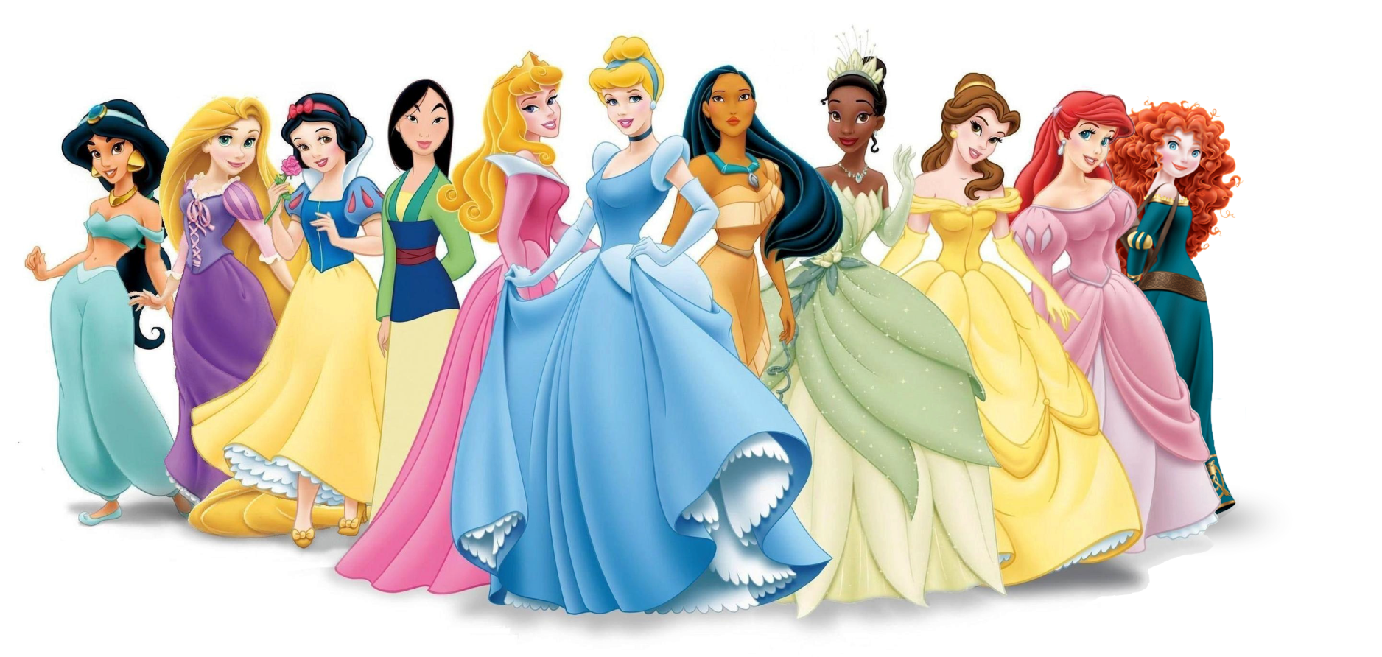
Archetype Definition
An Archetype is a common type of character or situation

Slide 8
Typical Fairytale Characters
Messenger | Bring news for the help of the hero
Hero (male or female) | Endures challenges Typically better off in the end
True Love (male or female) | Object of hero’s affection Hero battles for true love
Villain | Opposes hero Force of evil Monster
Friend | Hero’s friend often of lower class Shares a binding relationship
Royalty | King, queen, prince, or princess. Involves a castle
Poverty | Poor working girl/boy/family Trying to make enough to live

Slide 9
“You mean we’re just character types?”

Slide 10
Other Typical Fairytale Characteristics
Home | The starting / end point of the story Ordinary place, not magical
Bad Place | Place that poses a threat or challenge Hero desires escape
Limbo | Shadowy, mysterious, often a forest Hero often changes in limbo Hero makes deals
Magic and Enchantments | Magical forces at work Events explained beyond what is “normal”
Reoccurring Patterns and Numbers | Often things, phrases, or tasks appear in threes, sixes, or sevens.
Universal Truths | Usually sends a message about something we can all understand, usually about love, life, happiness...
Special Beginning and Ending | Once upon a time... Happily ever after... Sometimes they end with a surprise

Slide 11
“So they all follow the same pattern?”

Slide 12
Discuss:
List examples of fairytales that follow these rules, and ones that break them.

