Slide 1
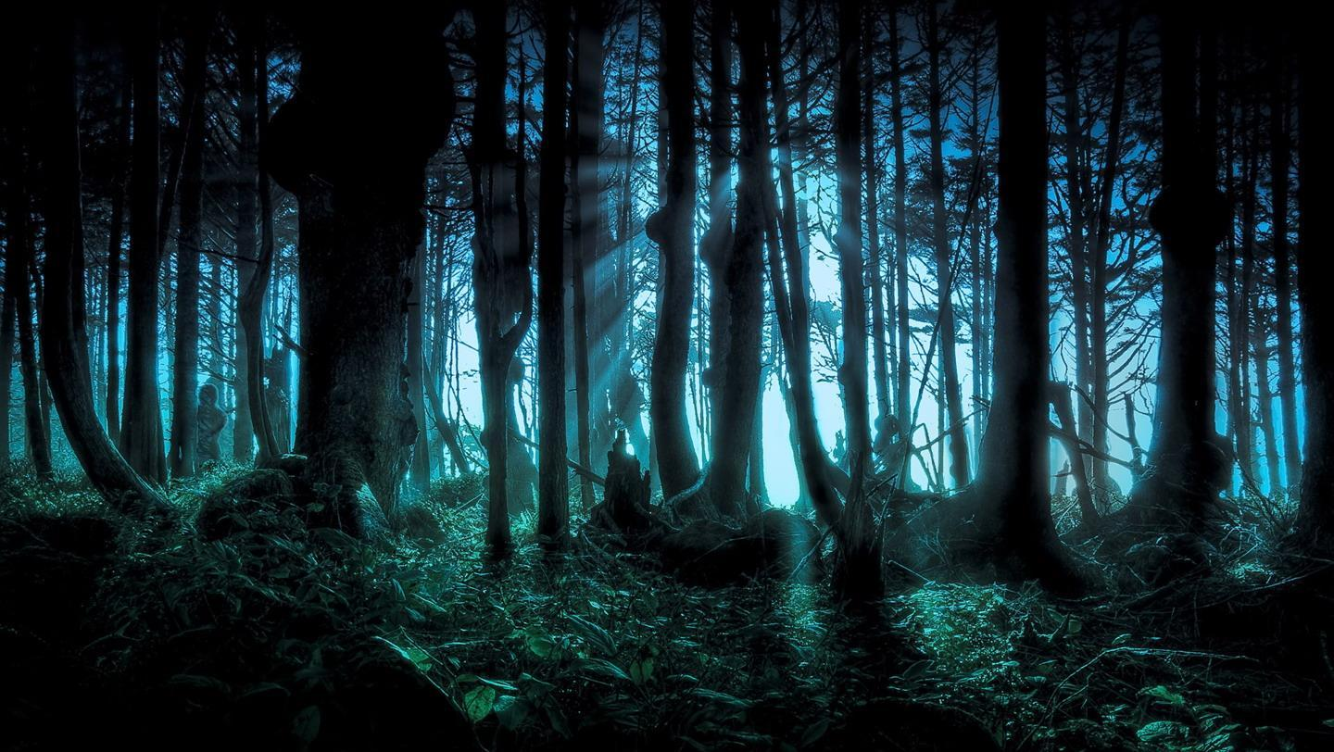
MYSTERY
ENG 4CI Preston High School

Slide 2
Discuss
What do you think of when you hear the word “mystery”?
What is the most important part of a mystery: the crime or the quest to solve it?
Why do you think people are so fascinated about true crime programming?

Slide 3
Essential Mystery Elements
Characters
Setting
Plot
Clues
Distractions
Structure

Slide 4
Characters / Archetypes (who is in the story)
Detective or Investigator – usually the protagonist
Usually the detective has / has had a relationship with the police.
Is he/she better? Does he/she work with the police?
Famous detectives include Sherlock Holmes, Dexter, Poirot, or Philip Marlowe.
Helpers – those offering assistance along the way – coworkers, sidekicks
Victim(s) – the target of the crime
Suspects – those thought to be the cause of or part of the crime
Witnesses – those who may have seen or may know more about the case

Slide 5
Characters / Archetypes (who is in the story)
Suspects – those thought to be the cause of or part of the crime
Witnesses – those who may have seen or may know more about the case

Slide 6
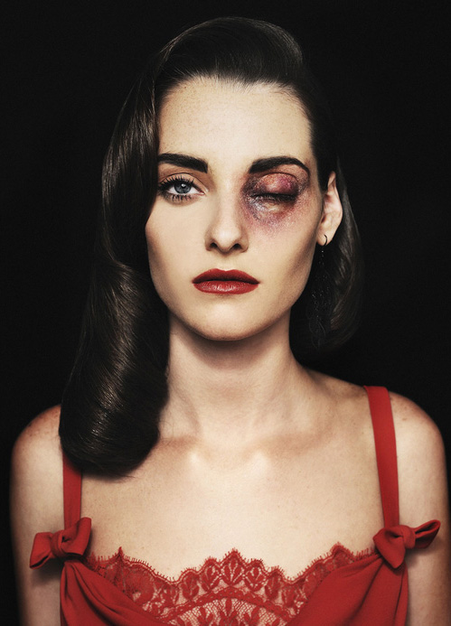
Women in Mystery: Victim or Trouble?
Victim
Usually portrayed as innocent and helpless
Builds sympathy with the audience
The brutalness of the crime demands a quick resolution

Slide 7
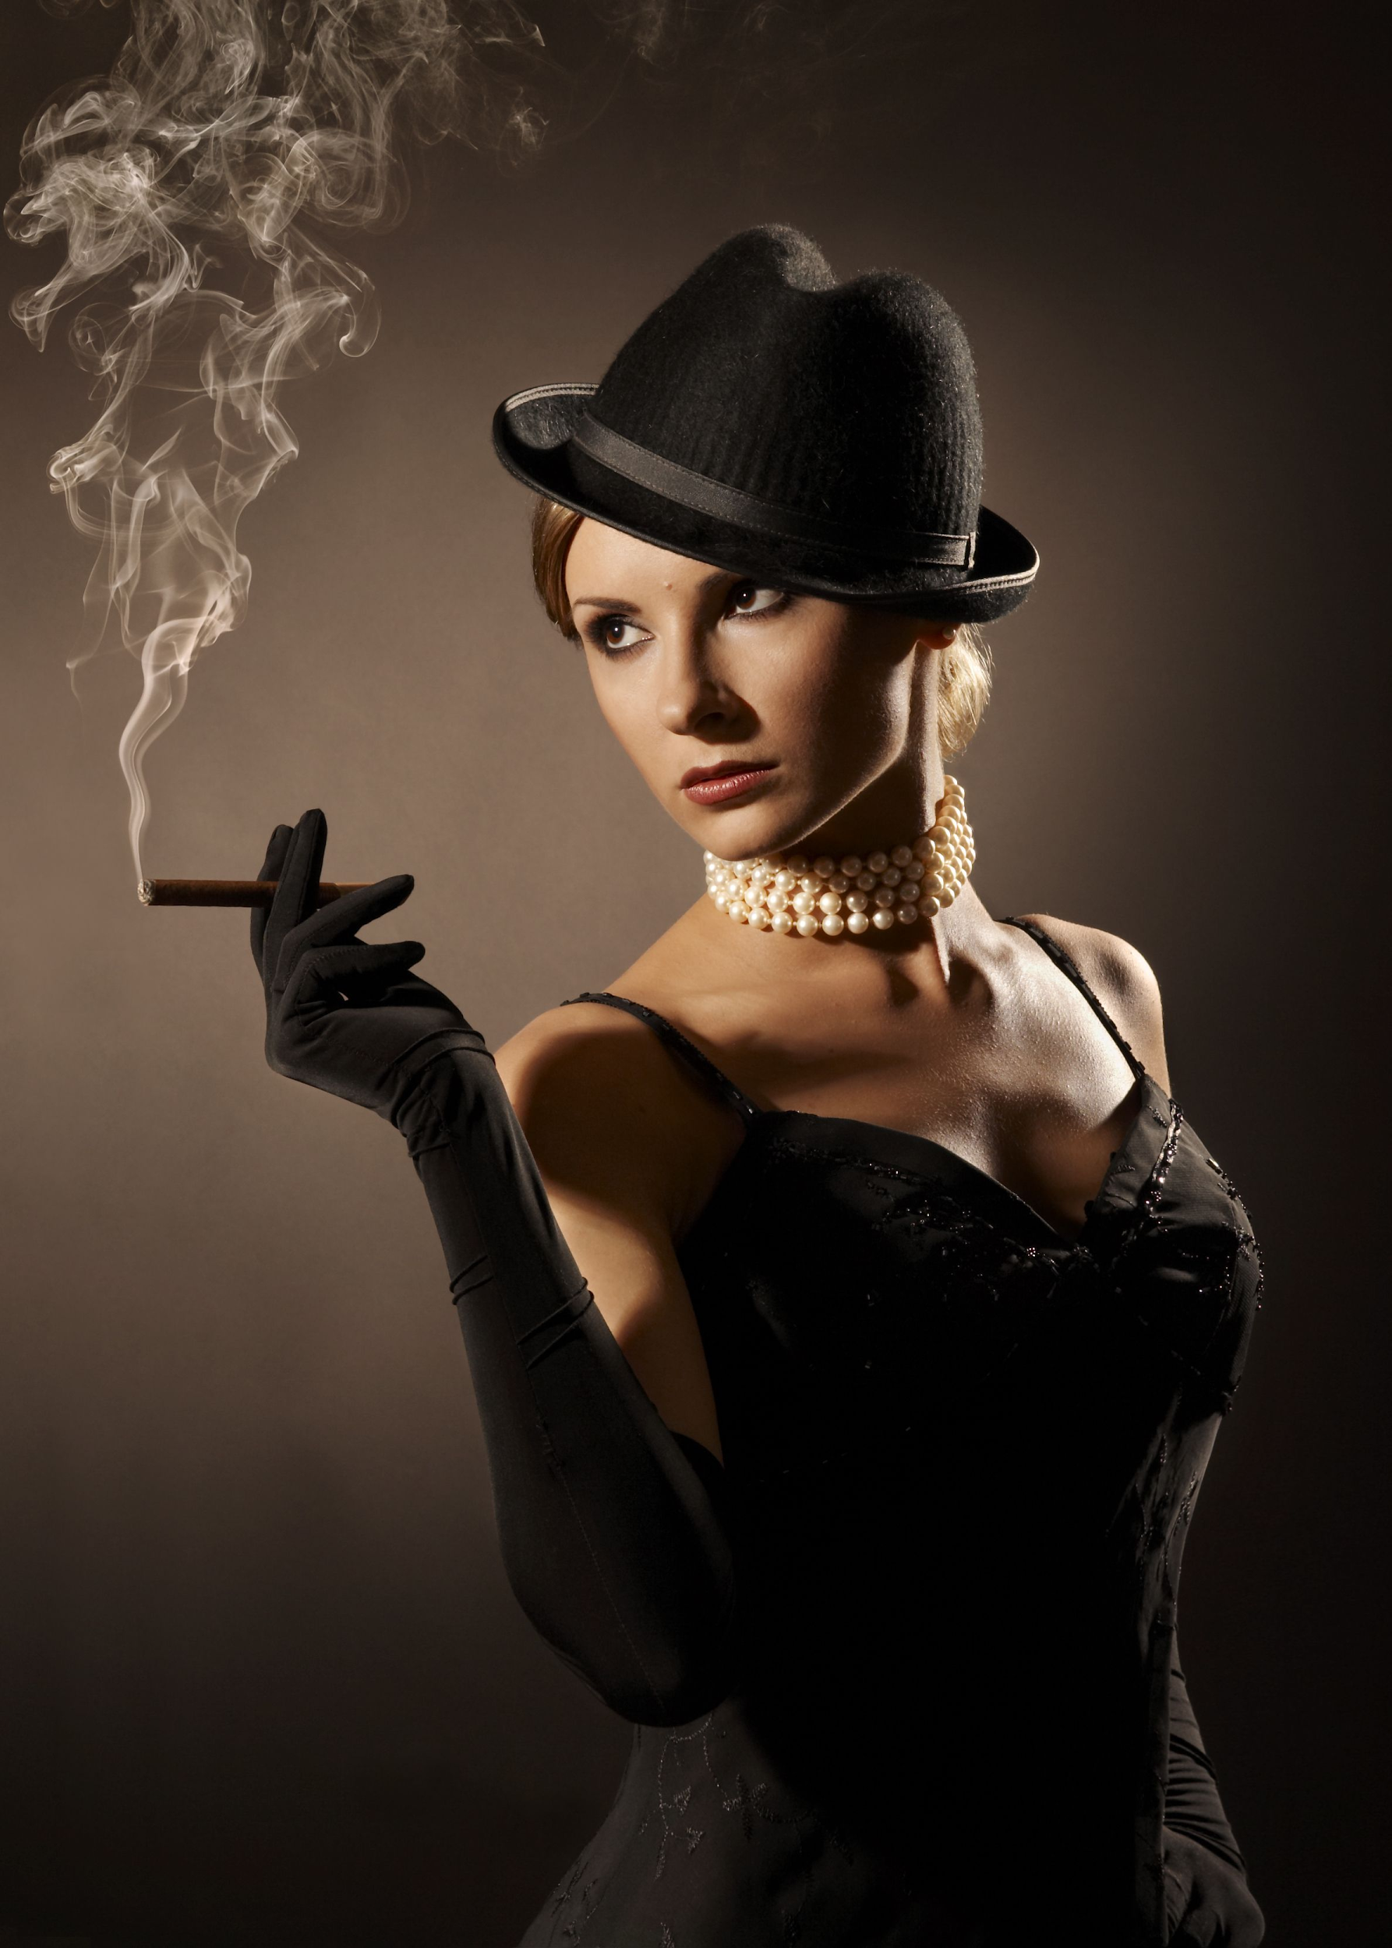
Women in Mystery: Victim or Trouble?
Femme Fatale: An attractive and seductive woman who will bring disaster to any man who becomes involved with her.
A bad past: She’s usually running from someone
Temptress: Tests the detective’s morality
Morally Grey: Do they intend to bring trouble

Slide 8
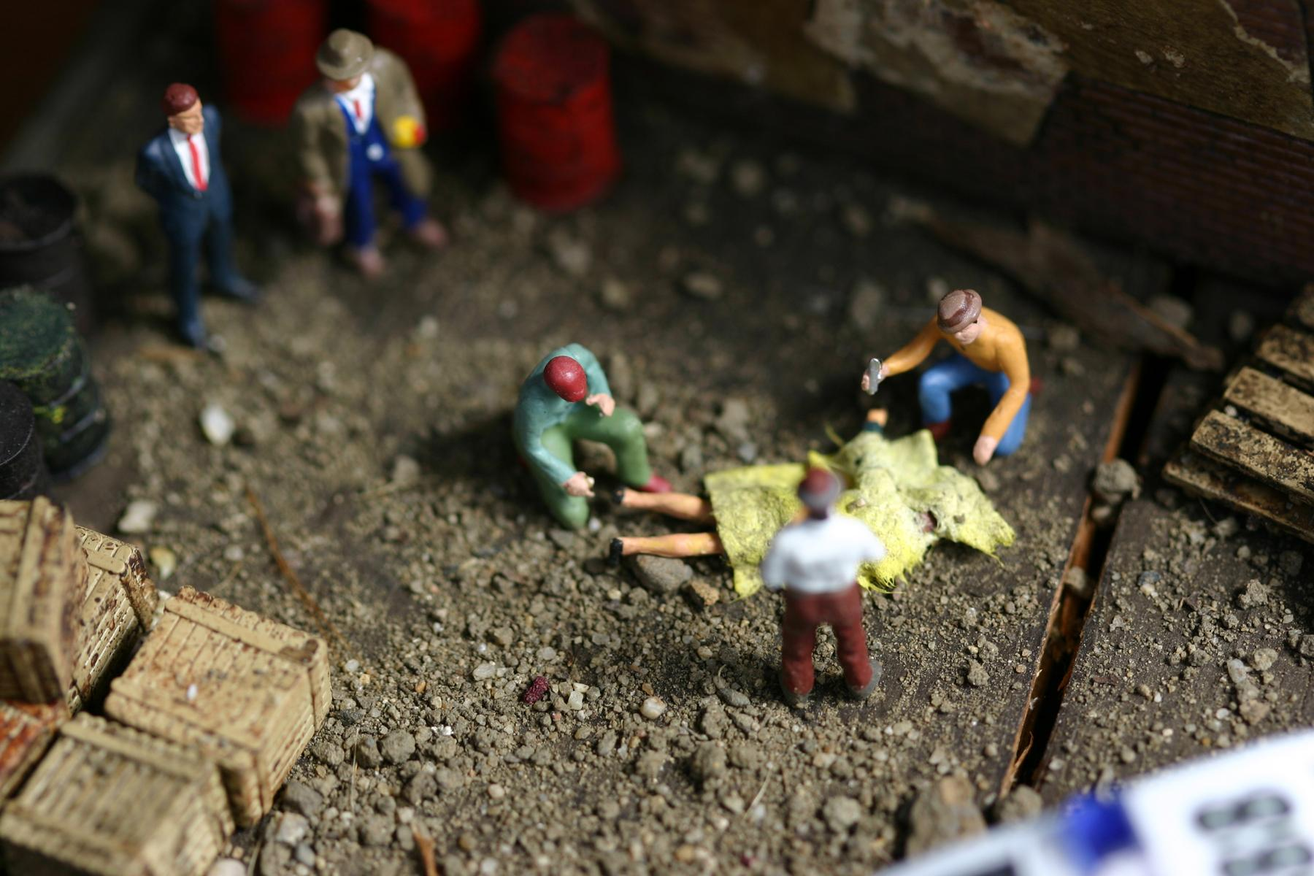
Setting (where the story happens)
Setting can vary, but some traits remain:
TIME – can be any time (era) and various times (of the day) – typically the more suspenseful parts take place at night.
ATMOSPHERE – typically, the darker and bloodier, more ominous a mystery is, the more interesting and urgent it is for the reader.
PLACE:
Crime Scene – typically emerges in the setting as the most important place
Place of Work – police station or patrole car
Various Locations – witness’ homes, new crime scenes as the case develops

Slide 9
PLOT (what happens in the story)
In no particular order, a good mystery includes:
Unusual Modus Operandi – Discovery of the criminal’s Method of Operation to have some unique features
A race against time – what’s a mystery without a pending deadline before more crime occurs?
Red Herrings – clues to throw the detective off the scent

Slide 10
PLOT (what happens in the story)
Intensity – yes as the case builds, but more at the end prior to its resolution
Methods of Investigation
Evidence collection, scientific, intuitive, research, interviews, etc.
Clues & Murder Weapon
Discovery of Lawbreaker
Some Degree of Violence

Slide 11
Just a guideline
Not all mysteries we experience will follow all components of this form.
Many break it, and deliberately so.
The point is to pay attention to when the rules are broken, and determine WHY.
Is it more interesting?
Should we sympathize more with a criminal?

Slide 12
CREDITS
-presentation created by Ms. Blaak

