Slide 1
Rhetorical Devices
For ENG 2PI

Slide 2
Rhetorical Devices
Are tools that writers use to persuade audiences
The Refugee Crisis:
https://youtu.be/RBQ-IoHfimQ
https://www.facebook.com/SmashCulturalMarxism/videos/870943053012556/?pnref=story

Slide 3
Baised Language
Shows a feeling or opinion towards a product
Positive Language = perfume
Negative language = stink

Slide 4
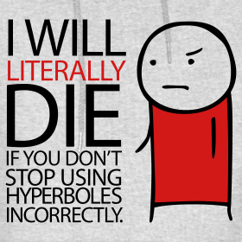
Hyperbole
An exaggeration to prove a point.

Slide 5
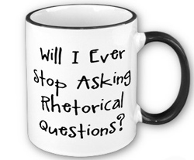
Rhetorical Question
Questions asked to make readers think. They don’t require an answer.

Slide 6
Repetition
Repeating words for emphasis

Slide 7
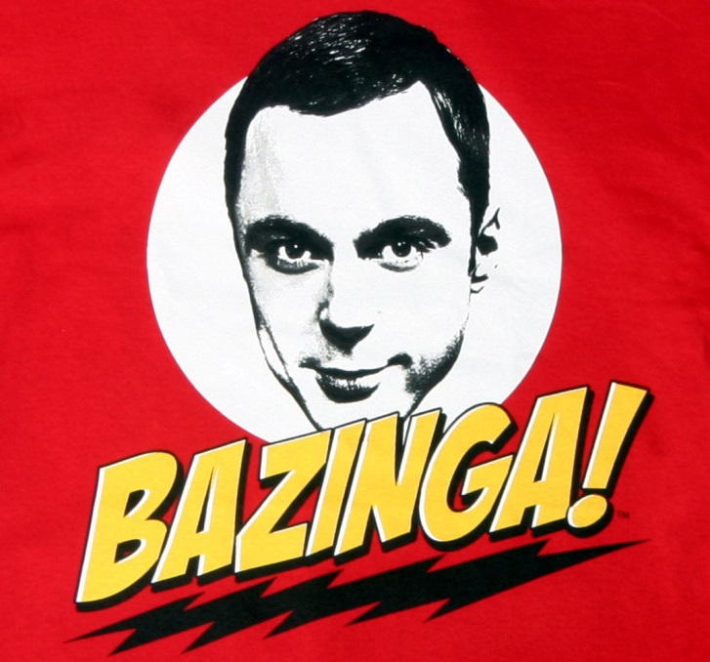
Allusion
A reference to something that everyone knows

Slide 8
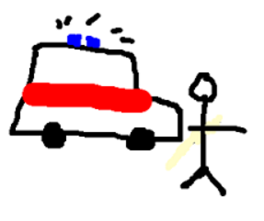
Irony
A saying or incident that is the opposite of what people expect

Slide 9
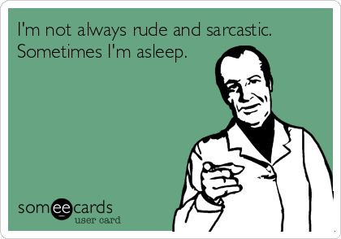
Tone
When a writer’s feelings are apparent in their tone (sarcasm or serious)

Slide 10
Three Types of Arguments
How the Devices are used

Slide 11
Character
Persuading an audience based on character or authority
You listen to your dentist because they are an expert

Slide 12
Emotion
Persuading an audience based on their emotions
People will give money if they pity someone

Slide 13
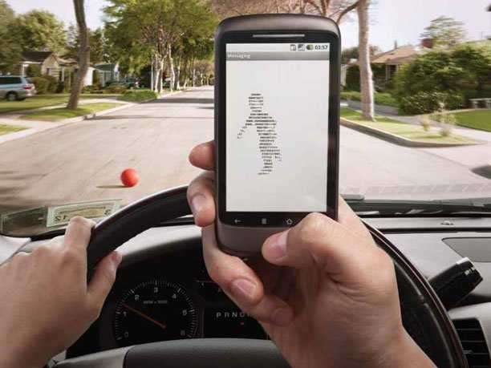
Logic
Persuading an audience based on their logic
Texting slows your response time more than alcohol.
Therefore, you
should never text
and drive.

Slide 14
Active Reading
Considering the Message and Audience

Slide 15
Active Reading
Active Reading means thinking about what you’re reading, when or after you’re reading.

Slide 16
Active Reading
Thinking about a text is more than picturing it in your head, but you should evaluate the author’s opinions, and whether or not you agree with them. The following terms will help you explain if a source is trustworthy, and why.

Slide 17
Bias
Bias is the author’s opinion. Author’s will often only show one side of an argument, and their position is their bias.

Slide 18
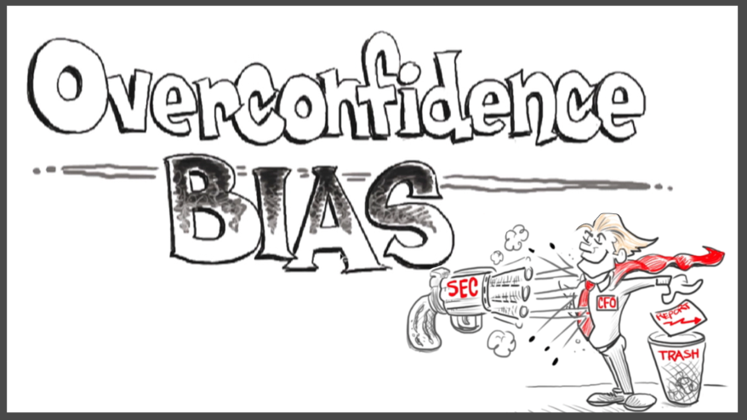
Extreme Ideas
If a writer or producer takes information in a ridiculous or extreme direction that relies heavily on misconceptions or bias, be wary of his/her argument.

Slide 19
Target Audience
Target Audience is who the article is written for. Authors will use specific rhetorical devices to appeal to a demographic (a group of people within a specific age, gender, or race)

Slide 20
Your Opinion
Your Opinion can be formed once you’ve considered all of these items, and then decide whether or not you agree with the article. Be sure to explain why or why not, with reference to the article and/or your own experiences.

Slide 21
Reliability
Is the information trustworthy?

Slide 22
Author
Who is the author? What educational background do they have?

Slide 23
Publisher
Who is the publisher? Is the author backed by a respectable source, or are they independent (like a blogger)

Slide 24
Timeliness
When is it written? Have opinions changed since then?

Slide 25
Formatting
Does the website look reputable (or is it filled with ads)? Are the ads for trustworthy, relevant things?

