Slide 1

Concepts and Quotes: Truth
ENG-4CI Mrs. Mitchinson-Schwartz & Mr. Bignell

Slide 2
Connecting to the novel
How do each of these messages relate to the storyline in the novel, The Knife of Never Letting Go?
Write down three of your favourites.
Notes:
1st time through

Slide 3
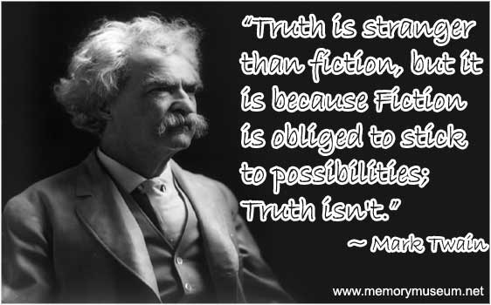
Notes:
2nd time through: Discuss use of font, images, credibility and how these choices relate to target audience. What might these choices tell us about the producer?

Slide 4
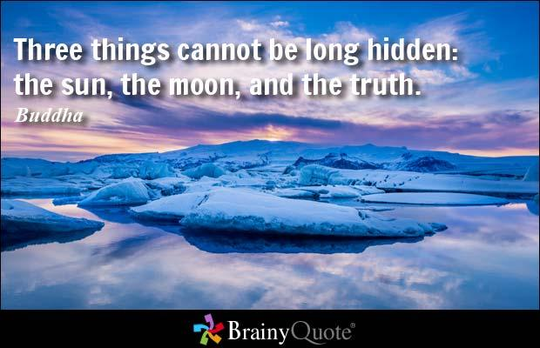

Slide 5
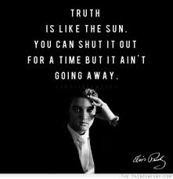

Slide 6
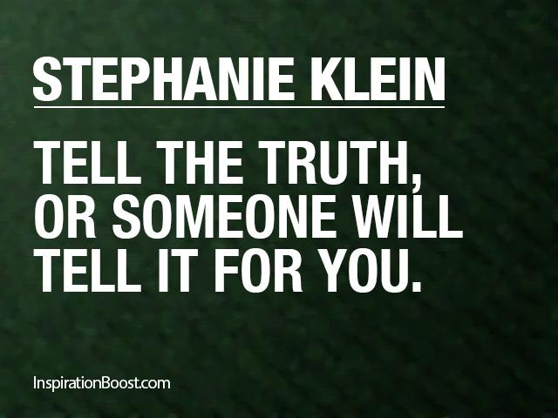

Slide 7

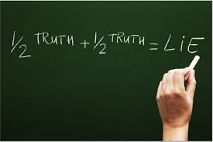

Slide 8
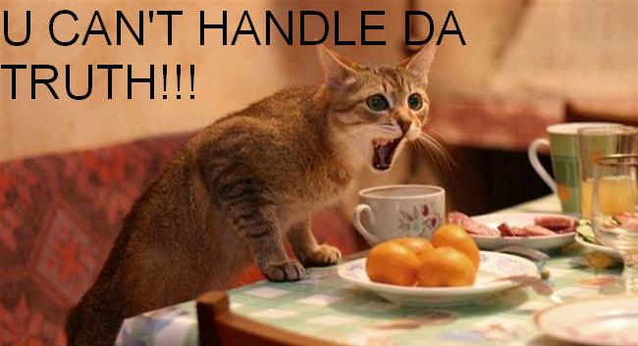

Slide 9
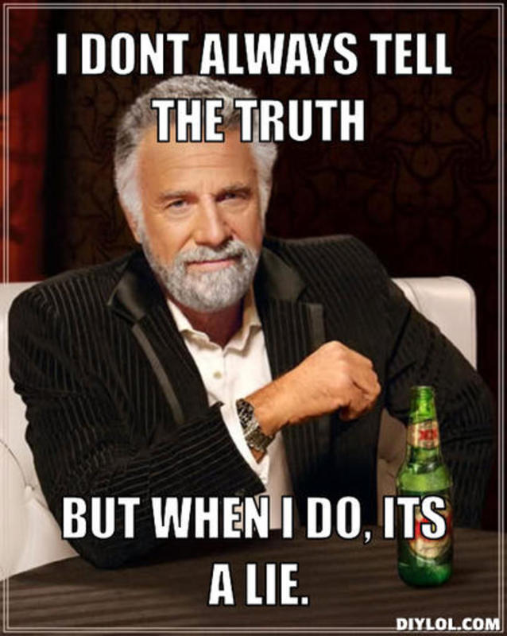

Slide 10
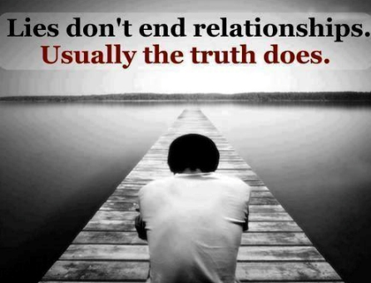

Slide 11

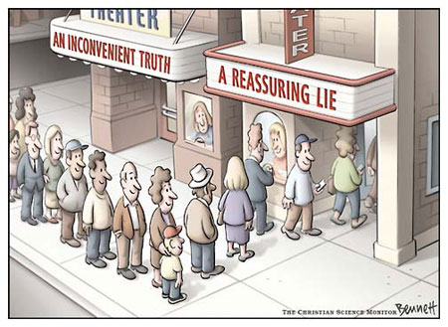

Slide 12
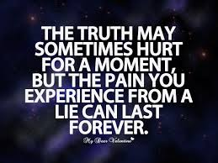

Slide 13
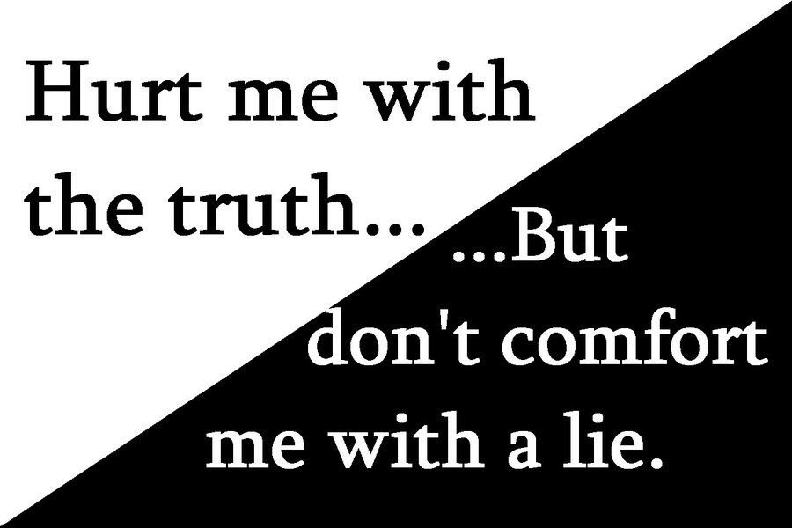

Slide 14
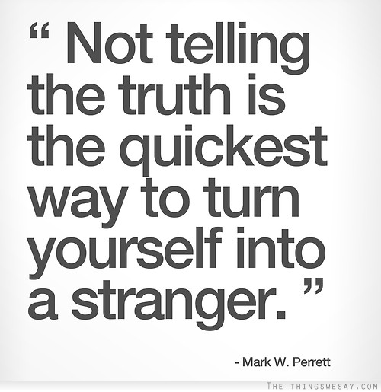
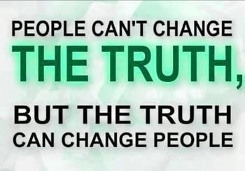

Slide 15
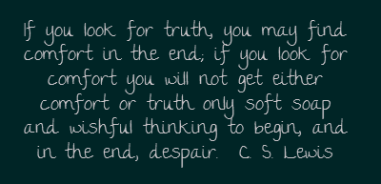
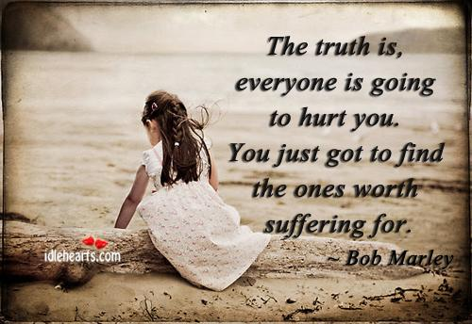

Slide 17
Create an inspirational quote on an emerging theme about truth in The Knife of Never Letting Go from the p-o-v of a character in the book. Use this to create a poster/collage “made by the character”. Think about colours, images, fonts and style that your character would use.

Slide 18
Make your own
Make your own motivational poster, meme, or quote around a lesson about truth. Be sure to follow the pre-production process through to post-production.
Notes:
WRITING Publishing 3.6 Use a variety of presentation features, including print and script, fonts, graphics, to improve the clarity and coherence of their written work and to heighten its appeal and effectiveness for their audience.
MEDIA STUDIES Purpose and Audience 1.1 Explain how media texts are created to suit particular purposes and audiences. 3.1 Describe the topic, purpose, and audience for media texts they plan to create and identify significant challenges they may face in achieving their purpose.
Evaluating Texts 1.3 Evaluate how effectively information, ideas, themes, issues, and opinions are communicated in media texts, and decide whether the texts achieve their intended purpose
Critical Literacy 1.5 Identify the perspectives and/or biases evident in media texts, and comment on any questions they may raise about beliefs, values, identity, and power.
Form 2.1 Identify general and specific characteristics of a variety of media forms and explain how they shape content and create meaning.
Conventions and Techniques 3.3 Identify a variety of conventions and/or techniques appropriate to a medium form they plan to use, and explain how these will help communicate a specific aspect of their intended meaning effectively.
Producing Media Texts 3.4 Produce media texts for a variety of purposes and audiences, using appropriate forms, conventions, and techniques
Metacognition 4.1 Explain which of a variety of strategies they found most helpful in interpreting and creating media texts, then evaluate their strengths and weaknesses as media interpreters and producers to help identify the steps they can take to improve their skills

